Slide 1
Session 5

Slide 2
Table of contents
01
02
03
04
Recap & Building server with Express
How Client Sends Data
CRUD Operations
Project Structure

Slide 3
01
Recap

Slide 4
Recap
What is the Backend
What is Nodejs, Express, JS, TS
what is a server-client connection
what is HTTP & HTTP Methods
What is an API

Slide 5
What is Backend
The brain of the application
Handles data, logic, security
Talks to databases

Slide 6
Backend Responsibilities
Authentication (login/signup)
Store & retrieve data
Business logic
Security & validation

Slide 7
What is ….. ?!
Nodejs
Express
JS & TS
It's a Runtime Environment
Runs JavaScript on the server
Fast & event-driven
Used for backend
It's a framework
Simplifies server creation
Handles routes & requests
They are just languages
Ts may be considered as a layer above js that adds types

Slide 8
Client - Server Connection
Client → Request → Server
Server → Response → Client

Slide 9
Code with Me!

Slide 10
What is HTTP?
Communication protocol
Request / Response
Stateless

Slide 11
HTTP Methods
GET → Read
POST → Create
PUT → Update
DELETE → Remove

Slide 12
What Is an API?
Application Programming Interface
Contract between client & server
Defines endpoints
Defines inputs & outputs

Slide 13
Types of APIs
REST (most common)
GraphQL
SOAP
gRPC.

Slide 14
Restful API
REST is a design style for building APIs
It defines how URLs, methods, and responses should be designed

Slide 15
REST Core Ideas
Resources, not actions
/users not /getUsers
Use HTTP methods
GET → Read
POST → Create
PUT / PATCH → Update
DELETE → Remove
Clear URLs
/users
/users/5
Stateless
Each request is independent
Standard responses
200, 201, 404, 500

Slide 16
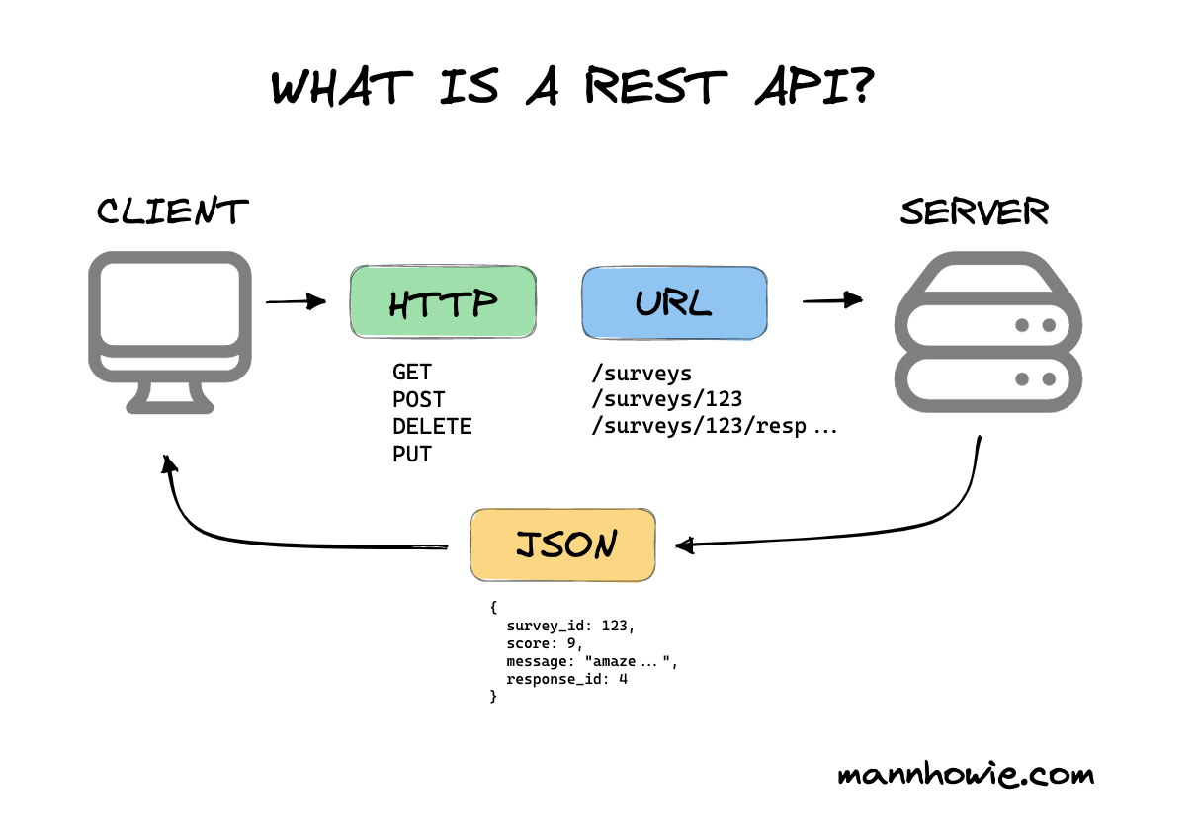

Slide 17
Code!

Slide 18
Table of contents
01
02
03
04
Recap & Building server with Express
How Client Sends Data
CRUD Operations
Project Structure

Slide 19
02
How Client Sends Data

Slide 20
How Client Sends Data
Ways Client Sends Data:
URL Params
Query Params
Request Body

Slide 21
Code!

Slide 22
Hands On

Slide 23
Hands On
Create a new GET endpoint
This endpoint should accept a name sent from the client
The server should respond with a welcome message must include the name sent by the client
Test Your Endpoint ,Use Postman or your browser
Try different names to make sure it works correctly

Slide 24
Table of contents
01
02
03
04
Recap & Building server with Express
How Client Sends Data
CRUD Operations
Project Structure

Slide 25
03
CRUD Operations

Slide 26
CRUD Operations
Create
Read
Update
Delete
POST
GET
PUT
DELETE
Mapped to:

Slide 27
Table of contents
01
02
03
04
Recap & Building server with Express
How Client Sends Data
CRUD Operations
Project Structure

Slide 28
04
Project Structure

Slide 29
Project Structure
Why Structure Matters
Maintainability
Scalability
Collaboration
Debugging & Testing

Slide 30
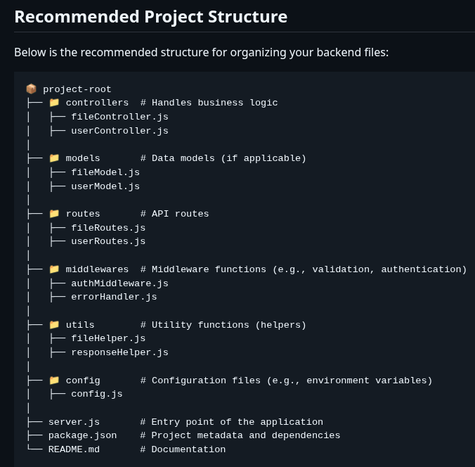

Slide 31
Code with Me!

Slide 32
Hands On

Slide 33
Thanks!

